Slide 1
DDD anche nei Dati?

Slide 3
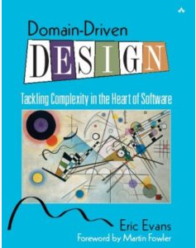
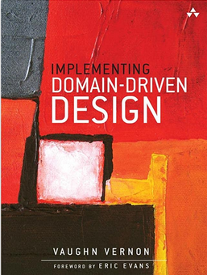
Domain-Driven Design

Slide 4
Pattern Strategici
Pattern Tattici
Ubiquitous Language
Bounded Context
Context Mapping
Entity
Value Object
Aggregate
Aggregate Root

Slide 5
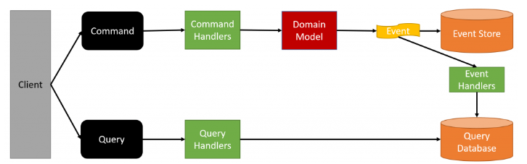
CQRS ES

Slide 6
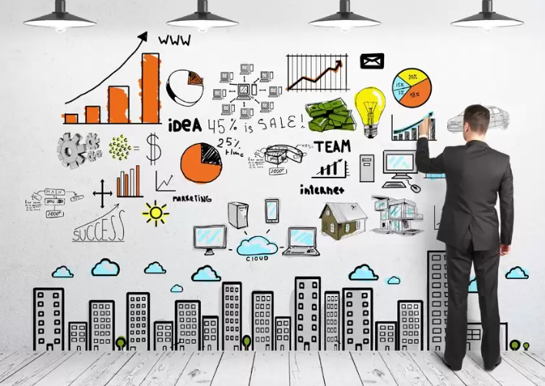
All we need is Data!

Slide 7
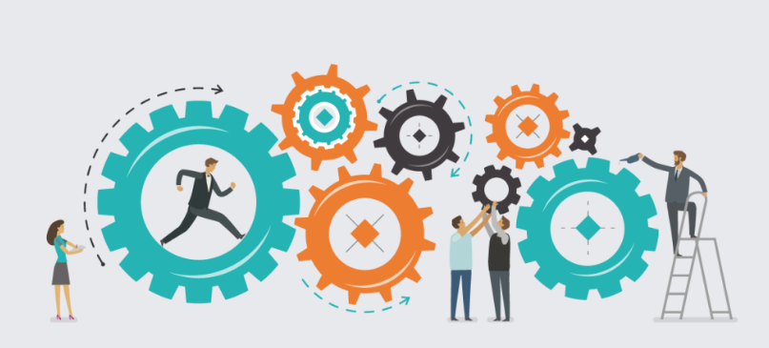
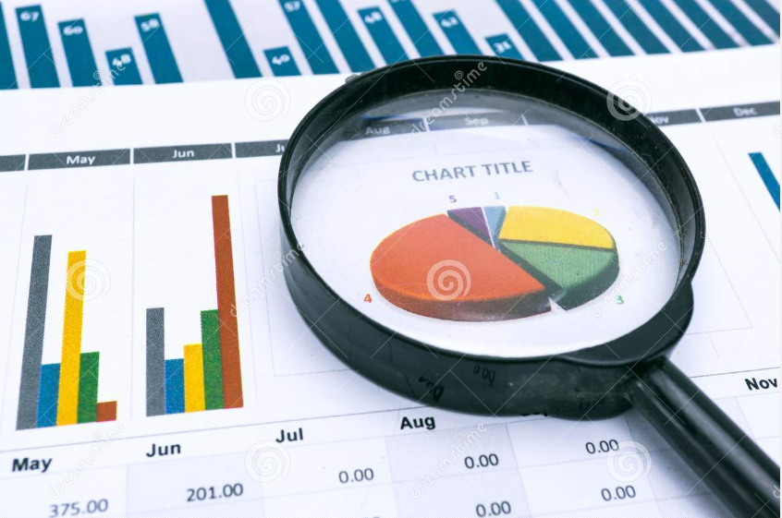
Operational vs Analytical
Operational
Analytical

Slide 8
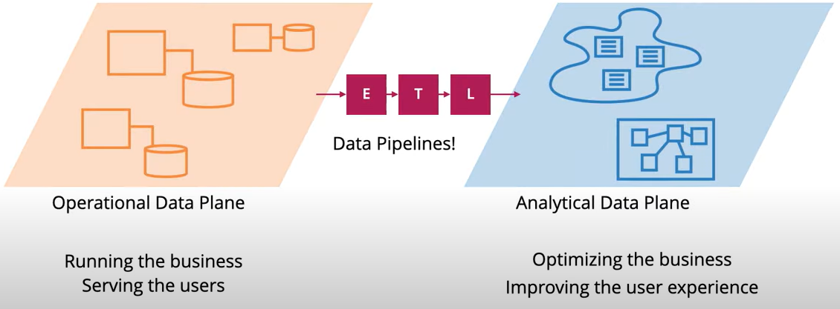
Misintegration

Slide 9
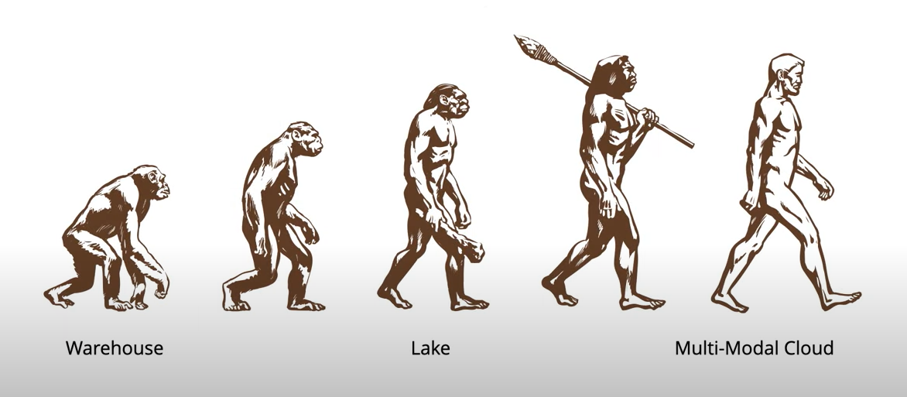
Evolutionary Improvement

Slide 10
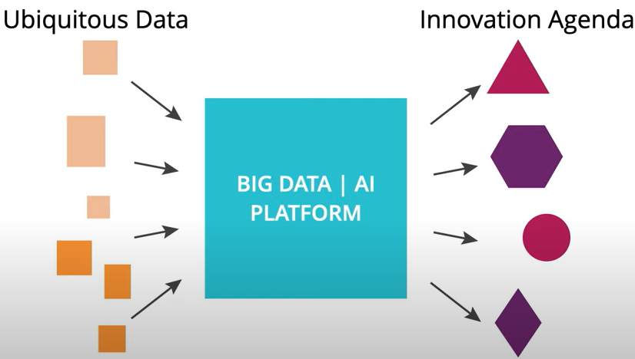
Centralized Monolithic

Slide 11
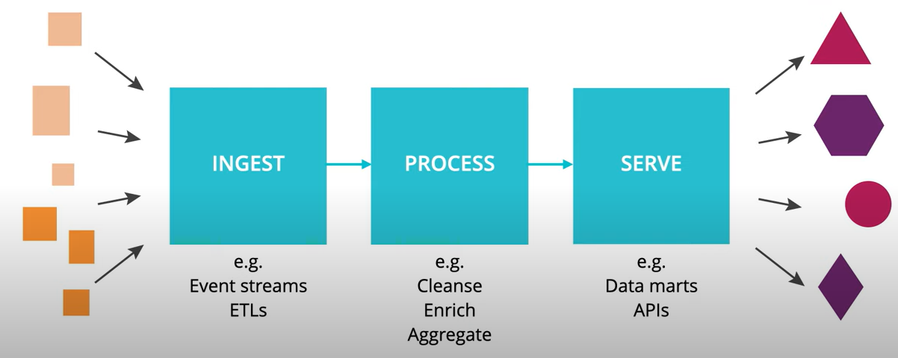
Technical Decomposition
Scale Architecture with top-level technical partitioning

Slide 12
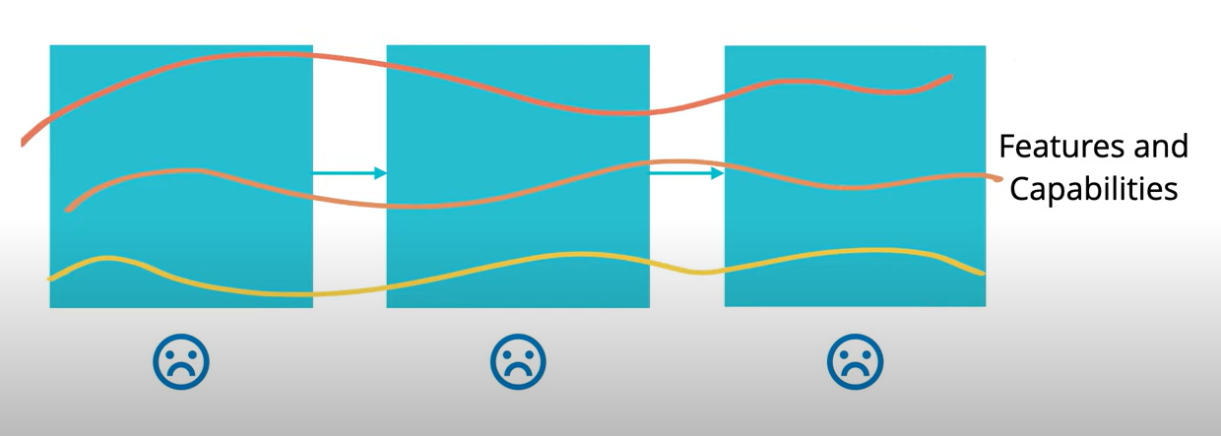
Task-Oriented Teams
Architecture decomposition orthogonal to change

Slide 13
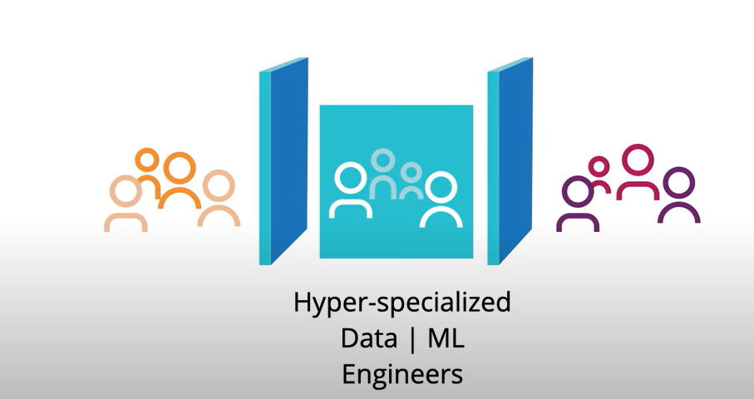
Hyper-Specialized Silo
Hyper-specialized Data or ML Engineers

Slide 14
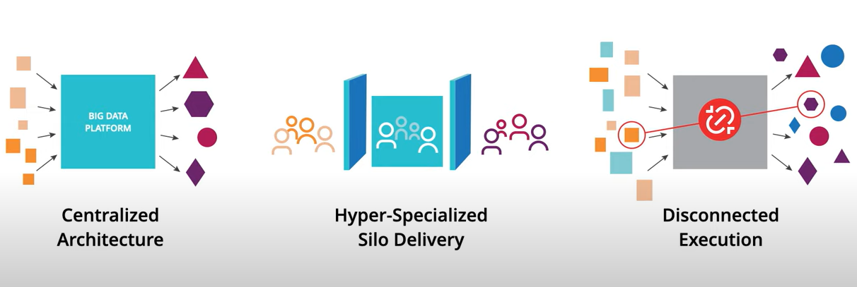
Data Today
… and yet, the failure model remain

Slide 15
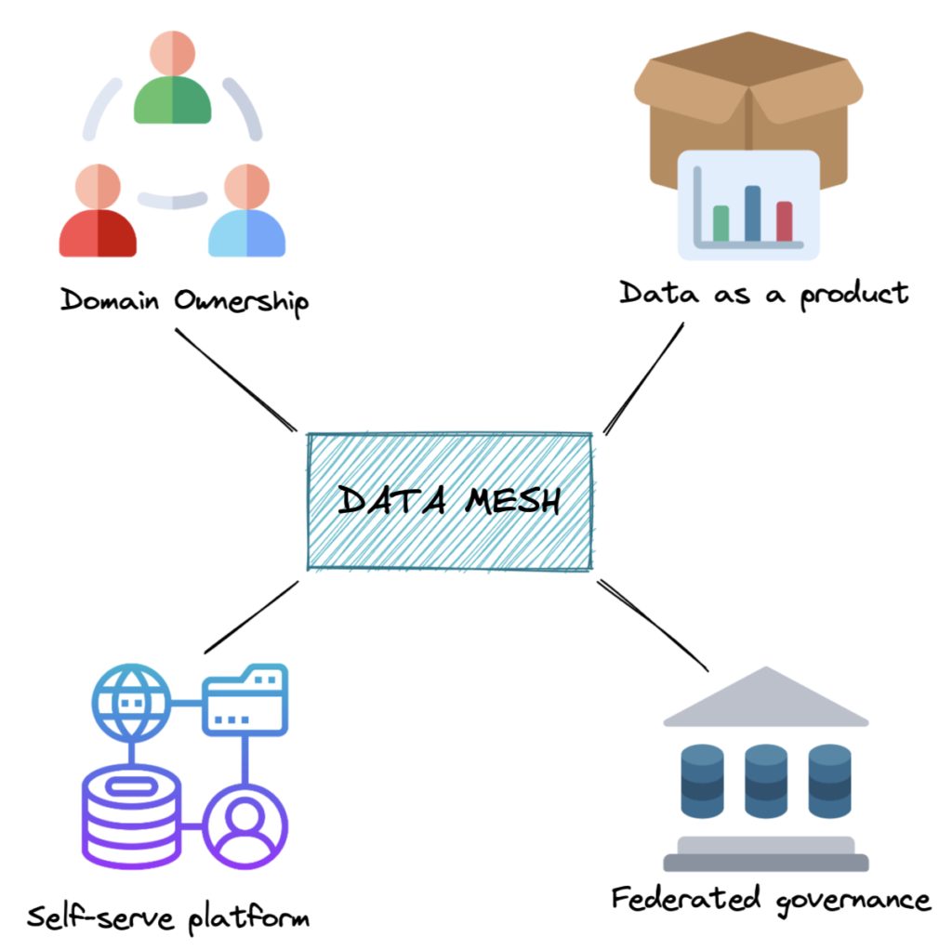
Data Mesh

Slide 16
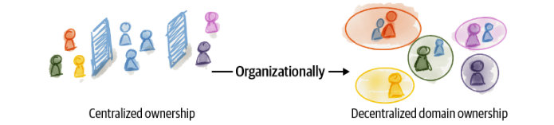
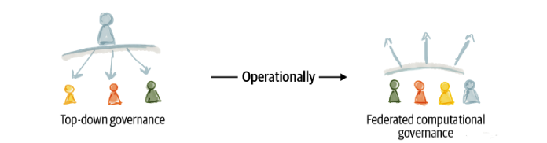
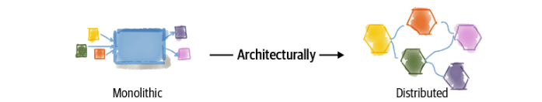
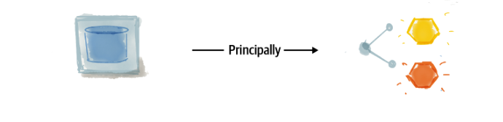
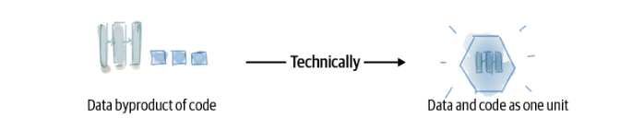
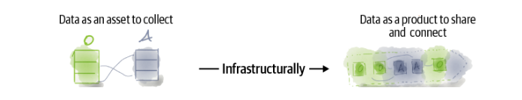
Data Mesh dimensions of change

Slide 17
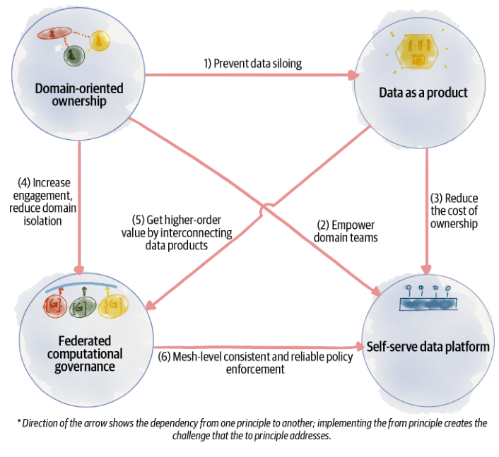
The Principles

Slide 18
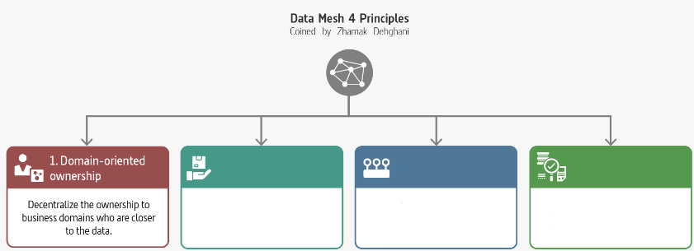
Domain-Oriented Ownership

Slide 19
Decompose Data Around Domains
Domains aligned with the origin of data
Domains aligned with the consumption
Domains aligned with shared aggregates
Distributed the ownership

Slide 20
Transformation to Domain-Oriented Data
Flowing data
Serving data at the source
One canonical model
Multiple models
The source of truth
The most relevant copy
Pipeline as a first-class concern
Domain’s internal implementation
Technology-driven decomposition
Domain-oriented distribution

Slide 21
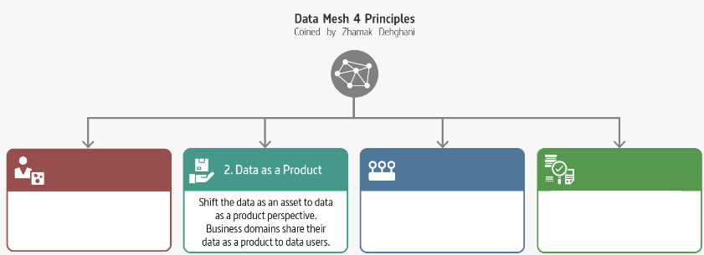
Data as a Product

Slide 22
A Succesful Product
Usable
Discoverability
Trusthful (trustworthy)
Interoperable
Valuable
Understanding
Natively Accessible
Feasible
Marty Cagan «Inspired»
Don Norman «The design of every day things»
«A confident relationship with the unknown» Rachel Botsman

Slide 23
Transformation to Data as a Product
Data as an asset
Data as a product
Byproduct
Product
Data as an output of compute
Data and compute as one unit

Slide 24
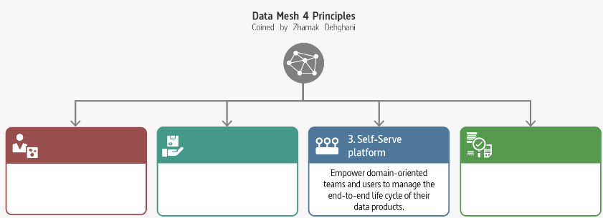
Self-serve Data Platform

Slide 25
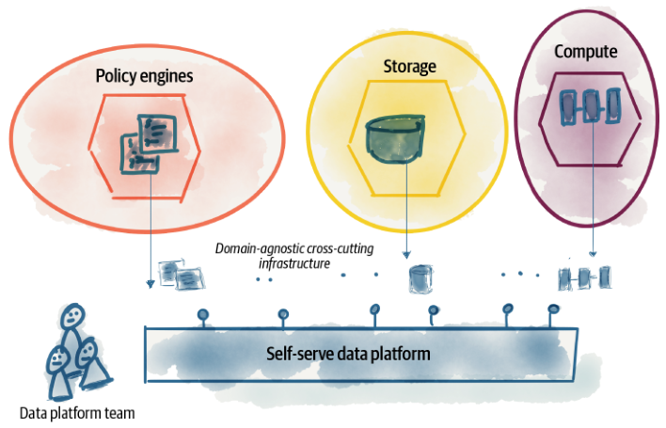
Self-Serve Data Platform
Extracting and harvesting domain agnostic infrastructure into a separate data platform

Slide 26
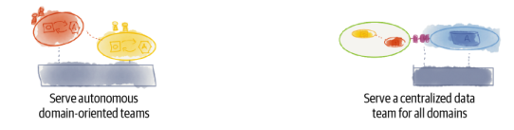
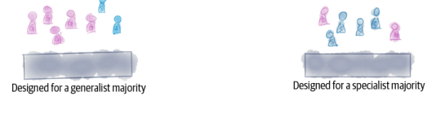
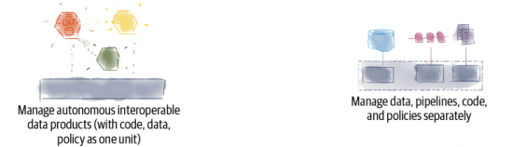
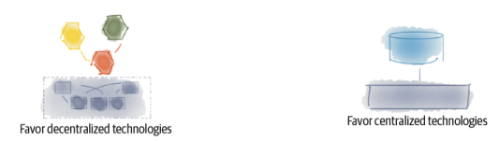
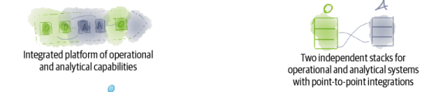
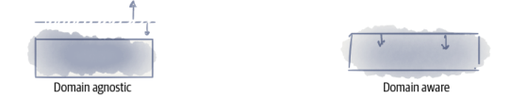
Data Mesh vs Others
Data Mesh
Others
Data Mesh
Others

Slide 27


Domain Representatives
Data Product Owner
Data Product Developer

Slide 28
Transformation to Self-Serve Data Platform
Big platforms
Protocols
Specialists
Enthusiasts/Generalist
Imperative
Declarative
Mechanisms
Experiences

Slide 29
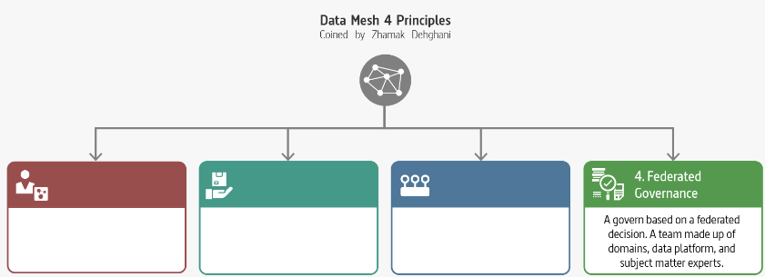
Federated Computational Governance

Slide 30
Decompose Data Around Domains
Federated Computational Governance
Decentralization and domain self-sovereignty
Interoperability through global standardization across data products
A dynamic topology
Automatic exection of decisions and policies by the platform
Maintains equilibrium between centralization and decentralization

Slide 31
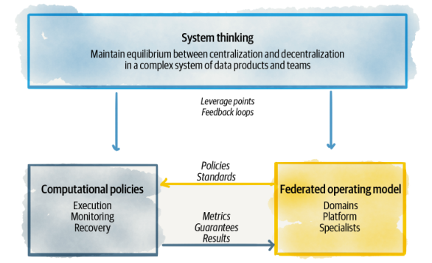
Equilibrium
Components of data mesh federated computational governance

Slide 32
Transformation to Federated Computational Governance
Centralized team of data experts
Federated team of domain owners and subject matter experts
Responsible for data quality
Responsible for defining what constitues quality
Responsible for data security
Responsible to define aspects of security
Responsible for canonical data modeling
Responsible for modeling polysemes
Measure success based on volume of data
Measure success based on value generated through network effect of the mesh-consumption of data

Slide 33
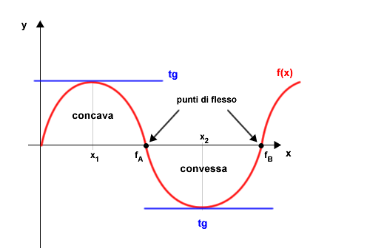
Why Data Mesh?

Slide 34

You hear that Mr. Anderson? That is the sound of inevitability …

Slide 35
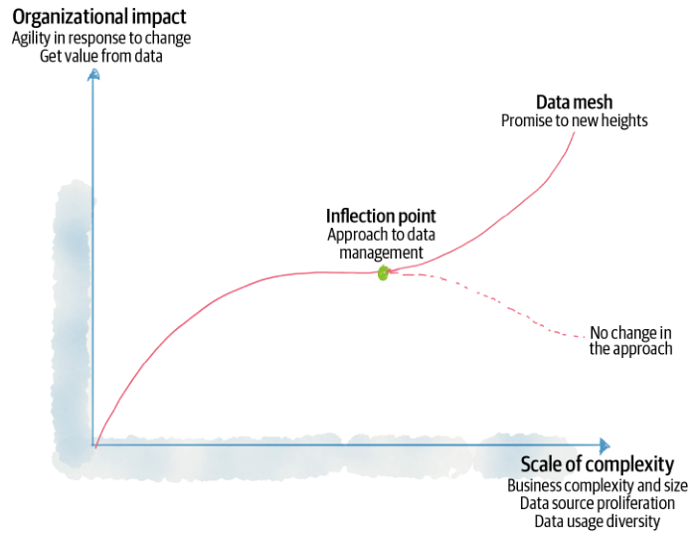
Data Mesh inflection point

Slide 36
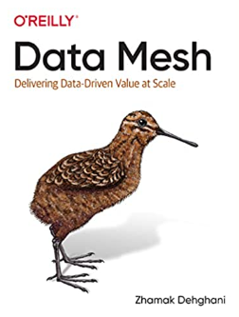

References
Zhamak Dehghani
Introduction to Data Mesh
Martin Fowler
Data Mesh Principles and Logical Architecture

Slide 37









alberto.acerbis@intre.it
https://github.com/brewup
https://github.com/cqrs-muflone
https://github.com/ace68
https://www.twitch.tv/dddbrewup

